Slide 1
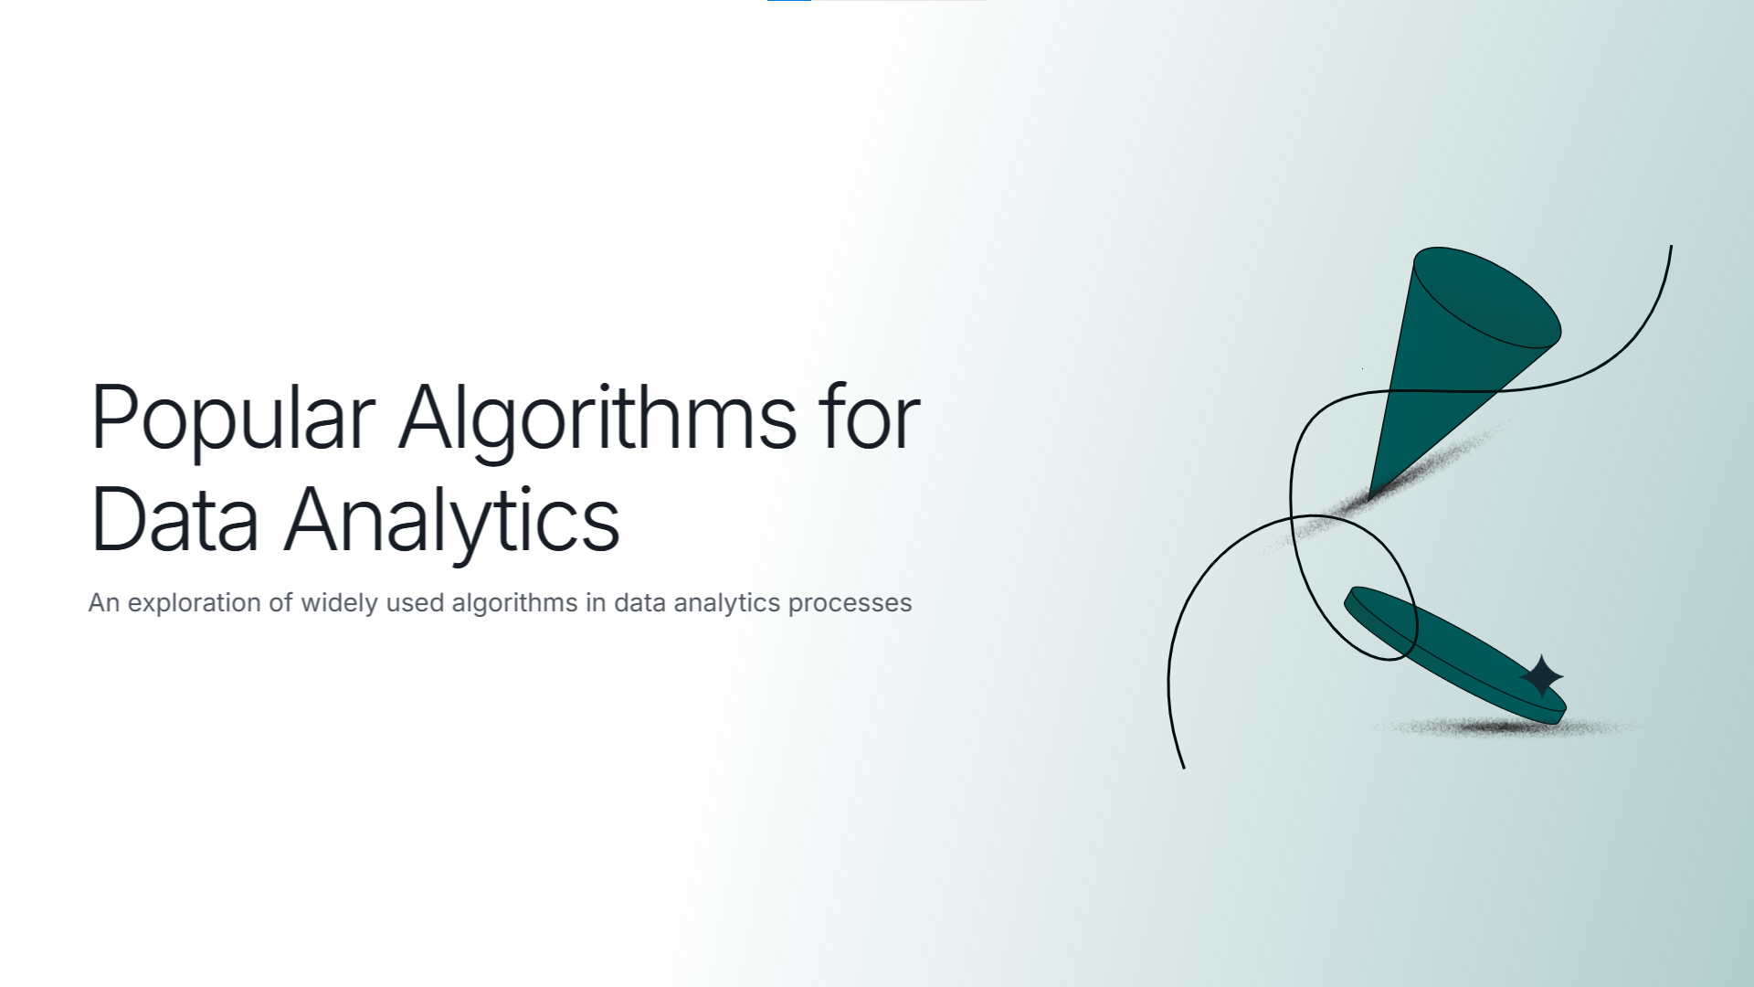
PRESENTED BY: 2101016

Slide 2

LINEAR REGRESSION
Purpose: Predicts continuous outcomes based on numerical values.
Key Concepts:
Establishes relationship between dependent and independent variables
Uses the equation: y = mx + b
Assumes linear relationship between variables
Application: Used in forecasting (e.g., sales predictions, pricing).
Pros: Simple, interpretable, fast computation.
Cons: Limited to linear relationships, Sensitive to outliers.

Slide 3

LOGISTIC REGRESSION
Purpose: Predicts binary or categorical outcomes.
Key Concepts:
Uses sigmoid function to map predictions to probabilities
Output between 0 and 1
Decision boundary is linear
Application: Spam detection, credit approval (yes/no).
Pros: Good for binary classification, Less prone to overfitting.
Cons: Struggles with complex patterns.

Slide 4
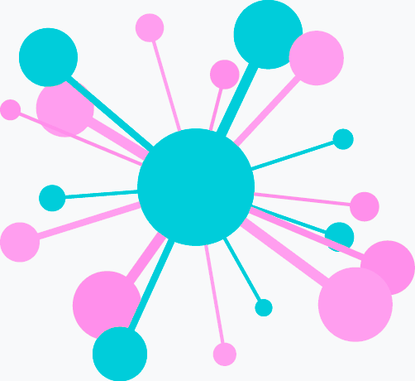
CLUSTERING (K-MEANS CLUSTERING)
Purpose: Groups similar data points without pre-defined labels.
Key Concept: Assigns data points to clusters by minimizing distances from cluster centers.
Application: Customer segmentation, image compression.
Pros: Simple, effective for segmentation.
Cons: Sensitive to initial cluster placement and outliers.

Slide 5
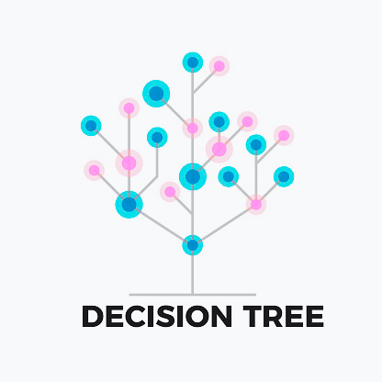
DECISION TREES
Purpose: Makes sequential decisions based on features.
Key Concepts:
Tree-like structure
Root node, internal nodes, leaf nodes
Information gain/Gini impurity
Application: Risk assessment, resource allocation.
Pros: Easy to interpret, handles categorical and continuous data.
Cons: Can overfit easily, unstable with small variations.

Slide 6
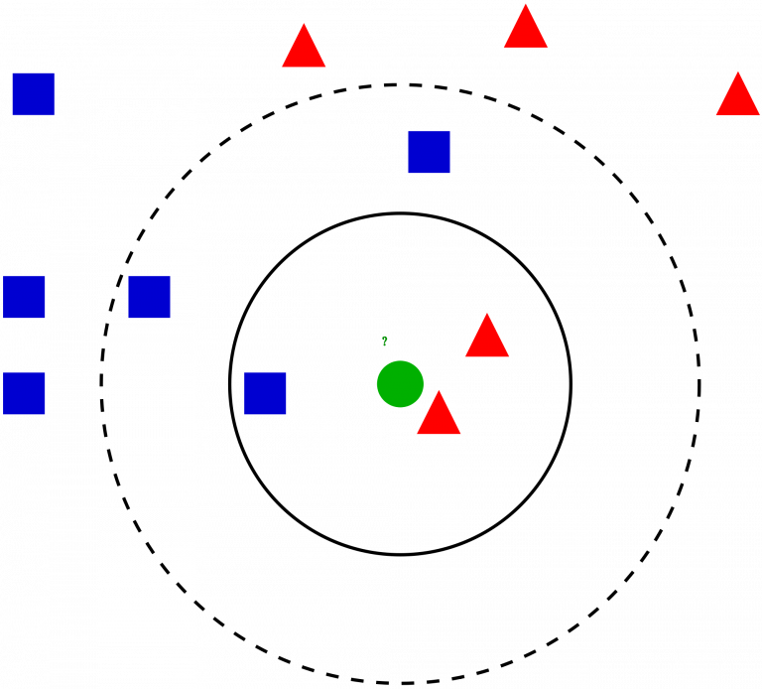
K-NEAREST NEIGHBORS (K-NN)
Purpose: Classification based on the "nearest" data points.
Key Concepts:
Non-parametric algorithm
Distance metrics (Euclidean, Manhattan)
Assigns a label based on the majority class of k-nearest points.
Application: Recommendation systems, image recognition.
Pros: Simple to implement, naturally handles multi-class cases.
Cons: Computationally intensive, sensitive to irrelevant features, requires feature scaling.

Slide 7
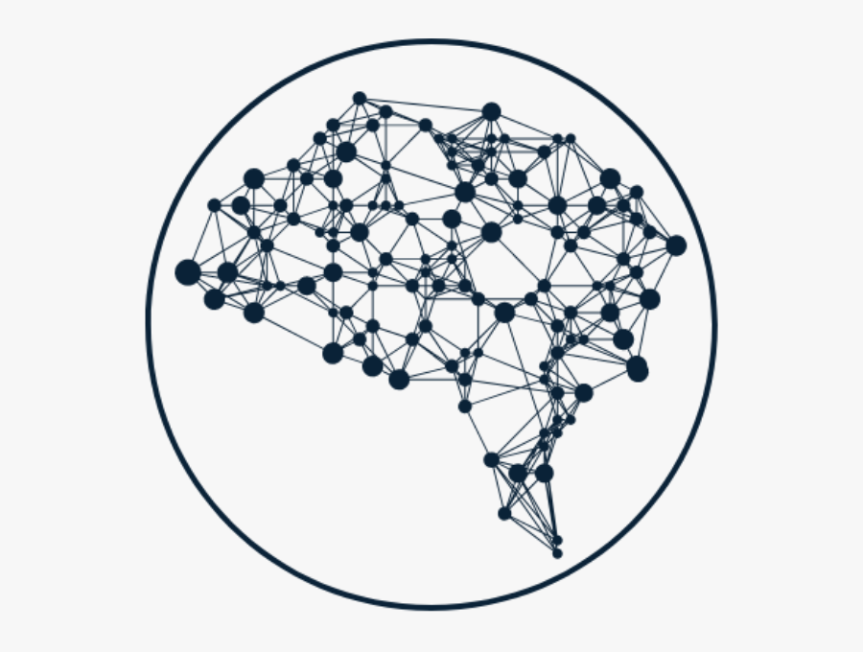
NEURAL NETWORKS
Purpose: Models complex patterns and relationships.
Key Concepts:
Layers of neurons
Activation functions
Backpropagation
Application: Image and speech recognition, language translation.
Pros: Captures complex non-linear relationships, automatic feature learning, highly adaptable.
Cons: Requires large data and computation resources.

Slide 8
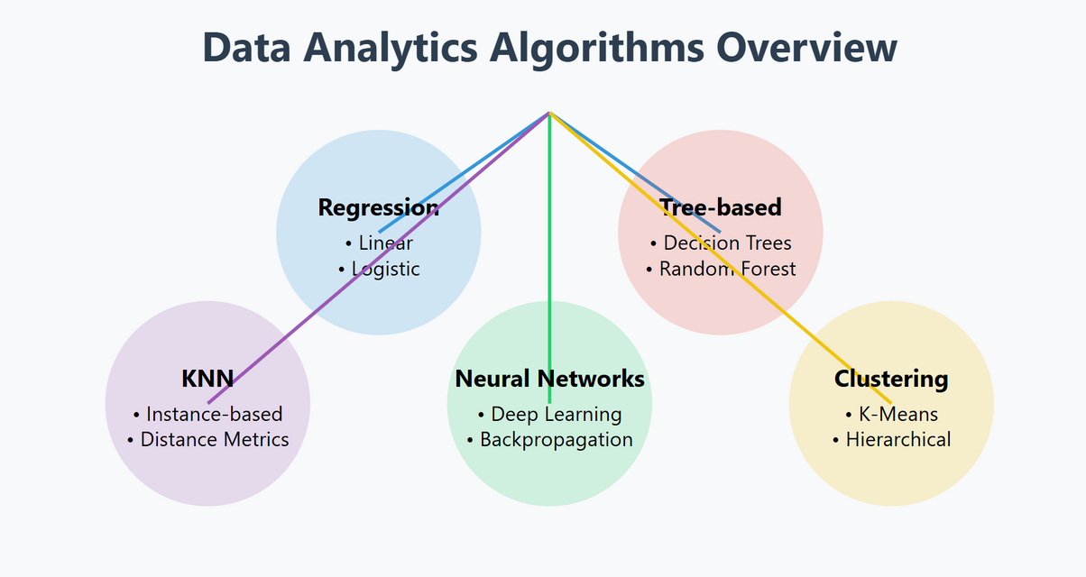
SUMMARY
Each algorithm has its unique strengths and optimal use cases:
Linear/Logistic Regression: Simple, interpretable predictions
Clustering: Discovering patterns in unlabeled data
Decision Trees: Transparent decision-making
KNN: Simple, instance-based learning
Neural Networks: Complex pattern recognition

Slide 9


